Slide 1
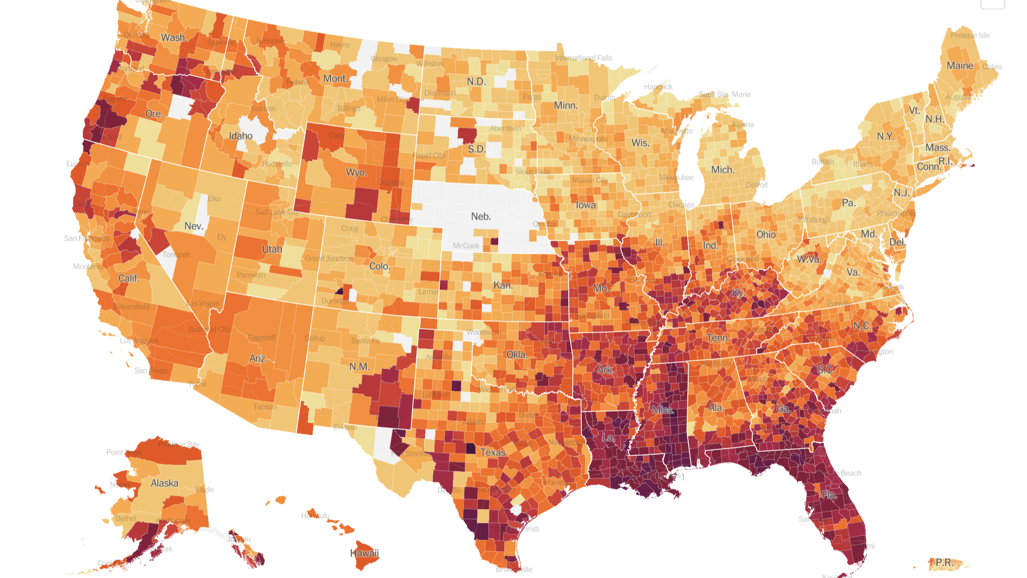
COVID-19 Diagnosis Prediction
Chenlu Huang
Jun Guo
MaoLiang Liu

Slide 2
Agenda
Motives and objectives of our project
Data exploration
Data preprocessing & feature selection
Imbalanced data handling: sampling
Modeling

Slide 3
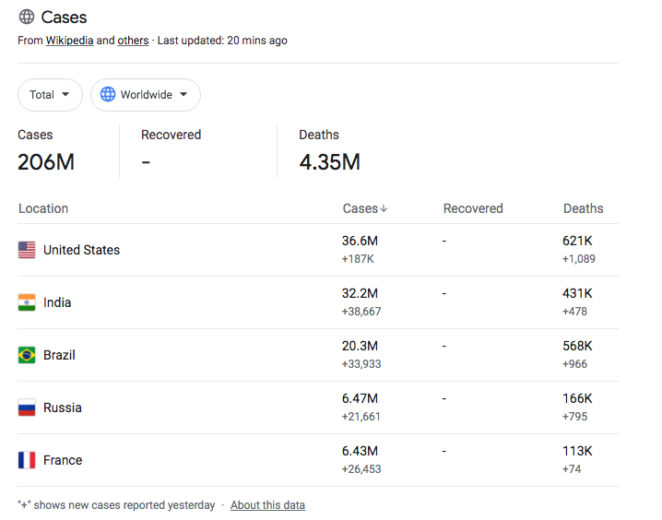
COVID-19 Worldwide Cases
Notes:
Worldwide Cases as of 8/14/2021
· This data is provided by Wikipedia, The New York Times, Our World in Data and JHU CSSE COVID-19 Data.

Slide 4
COVID-19 Delta Variant
The Delta variant causes more infections and spreads faster than earlier forms of the virus that causes COVID-19. It might cause more severe illness than previous strains in unvaccinated people.
Vaccines continue to be highly effective at preventing hospitalization and death, including against this variant.
Fully vaccinated people with breakthrough infections from this variant appear to be infectious for a shorter period.
Get vaccinated and wear masks indoors in public spaces to reduce the spread of this variant.
Notes:
Sourced from: https://www.cdc.gov/coronavirus/2019-ncov/variants/delta-variant.html

Slide 5
How to predict whether you have COVID-19 or not with supervised learning?

Slide 6

Data Exploration

Slide 7
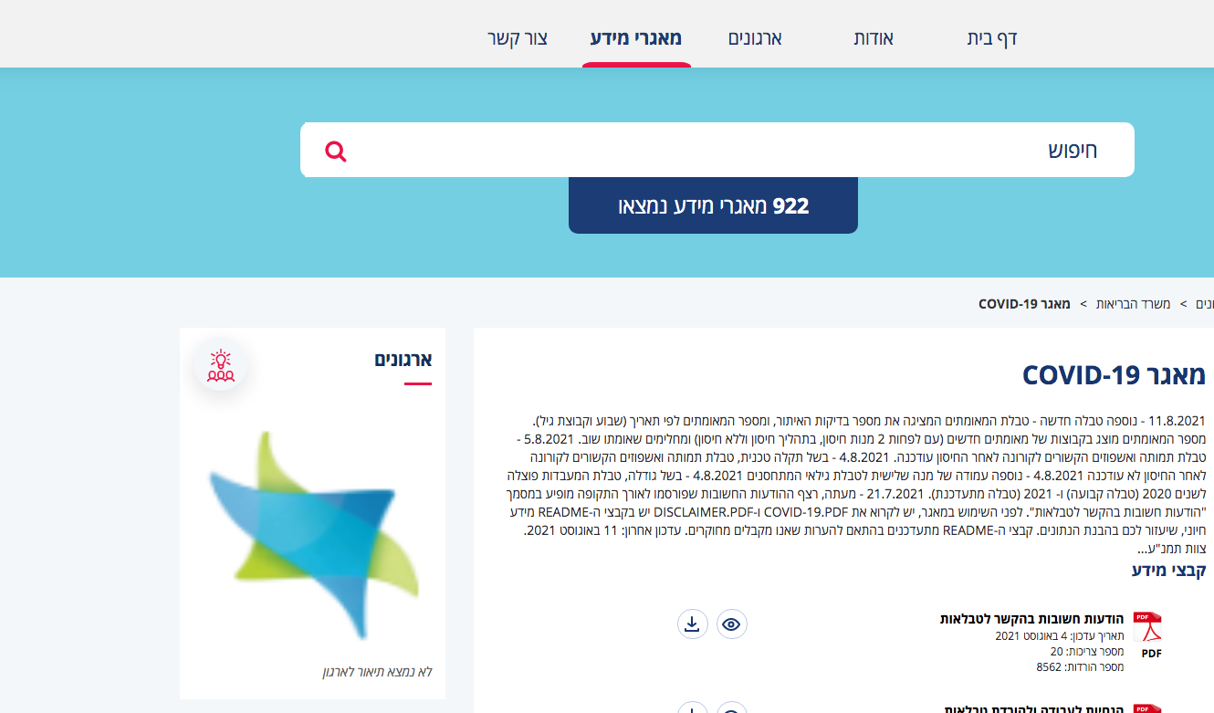
Israel Government Databases – COVID-19
https://data.gov.il/dataset/covid-19
Notes:
https://data.gov.il/dataset/covid-19/resource/0ac4cffc-3746-473a-8d4a-ab874b8d8d62

Slide 8
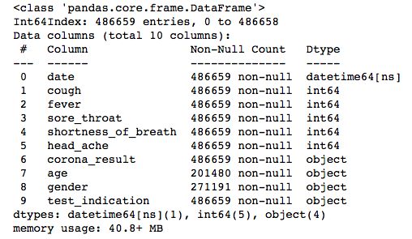
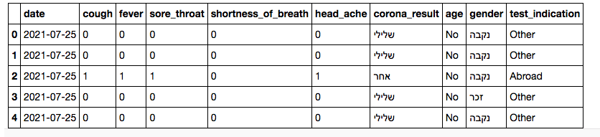
COVID-19 Data

Slide 9
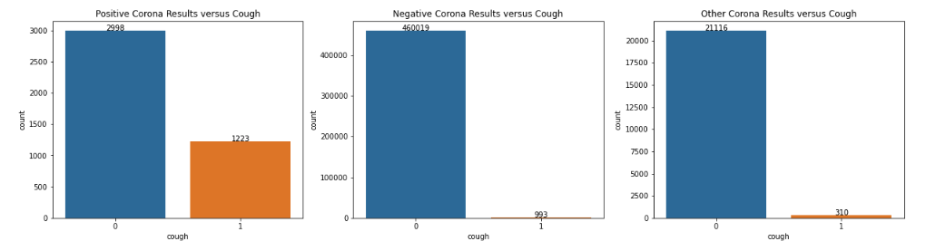
Breakdown of Cough

Slide 10
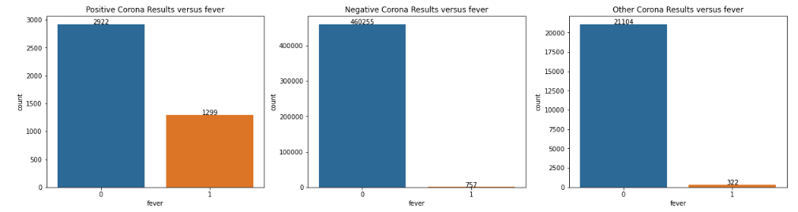
Breakdown of Fever

Slide 11
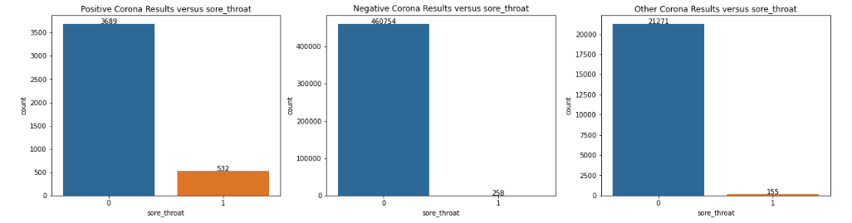
Breakdown of Sore Throat

Slide 12
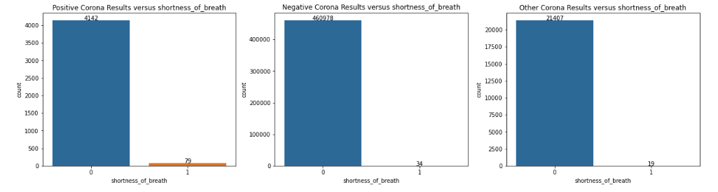
Breakdown of Shortness of Breath

Slide 13
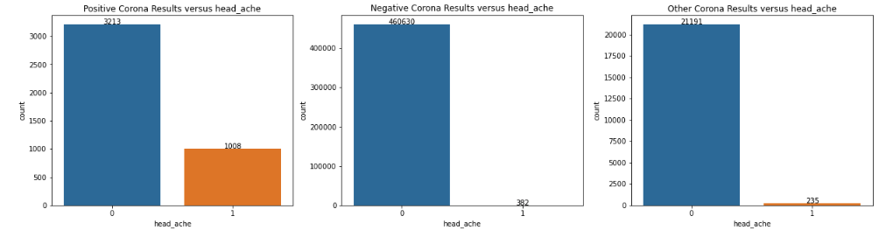
Breakdown of Headache

Slide 14
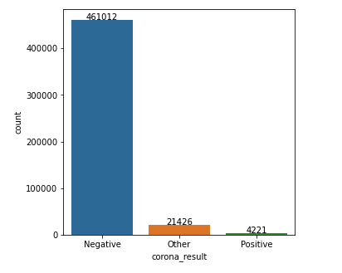
Imbalanced Dataset

Slide 15
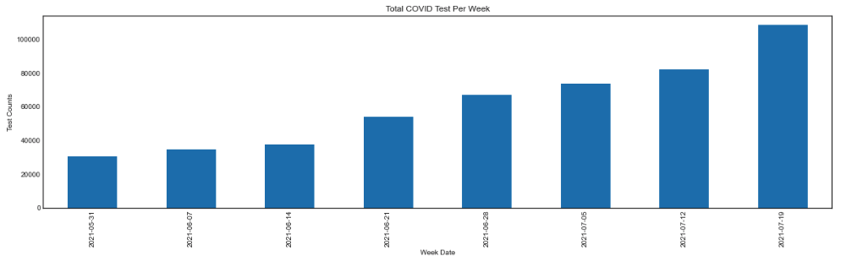
COVID Test Per Week

Slide 16

Data preprocessing

Slide 17
Features with null values
Feature | Total | Percent
age | 275466 | 0.592103
gender | 208245 | 0.447614

Slide 18
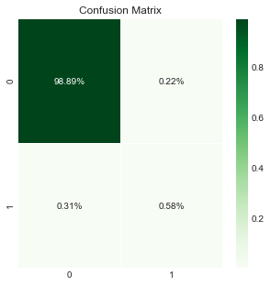
Original performance
 | Method | Original
0 | Balanced Accuracy | 0.824516
1 | Sensitivity | 0.994691
2 | Specificity | 0.654340
3 | AUROC | 0.824516
4 | F1 | 0.684547
5 | Geometric Mean | 0.806763
6 | Macro Average MAE | 0.175484

Slide 19
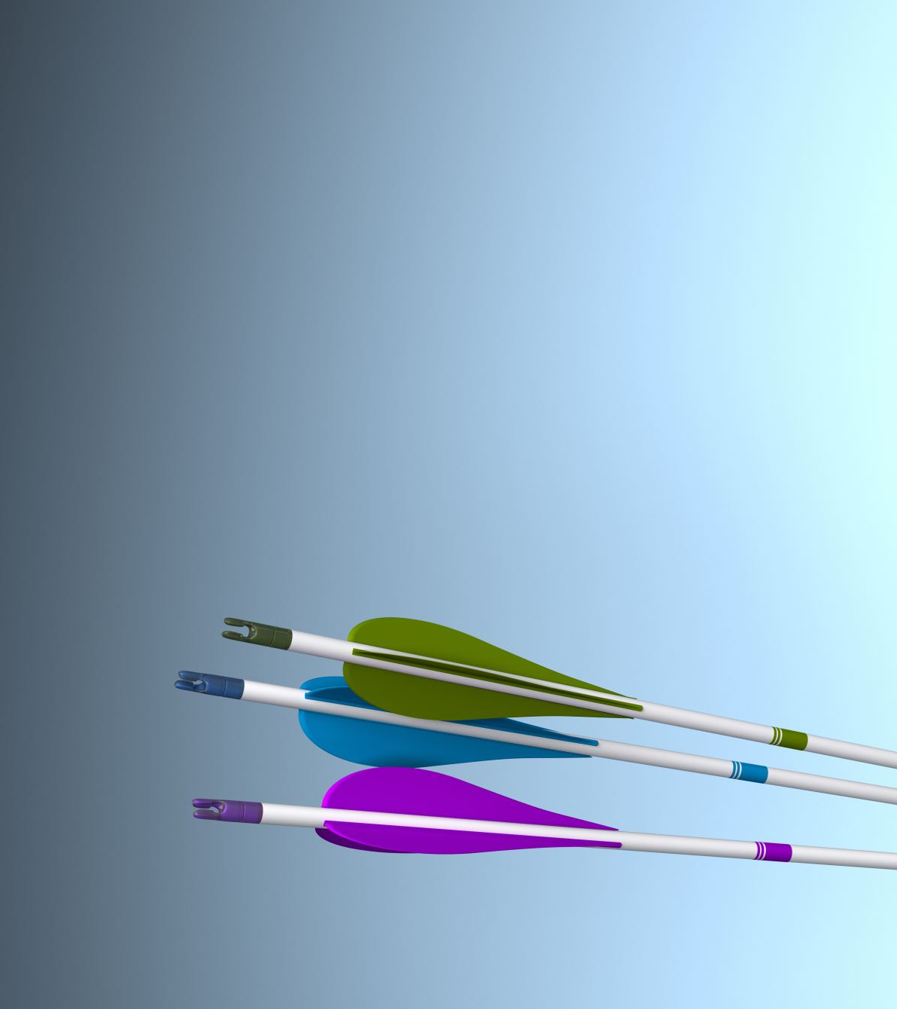
Feature Selection

Slide 20
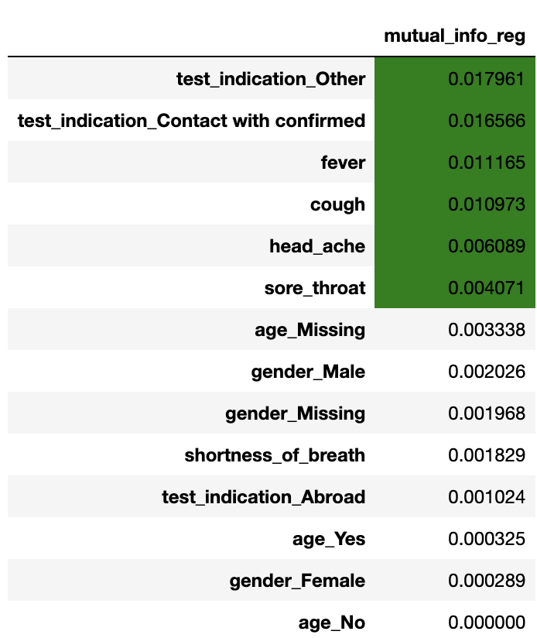
Mutual information

Slide 21
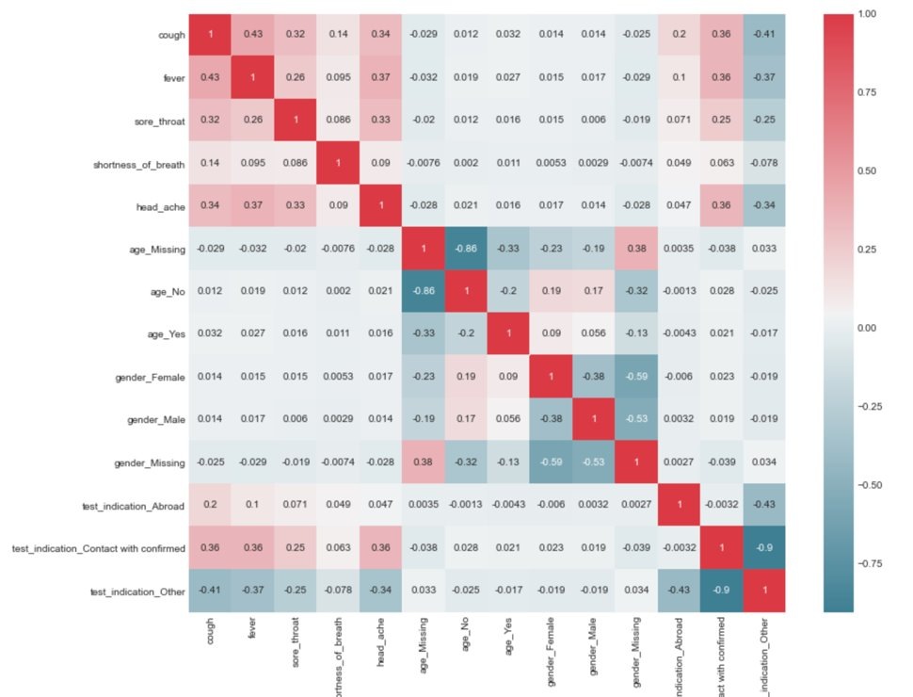
Correlation matrix

Slide 22
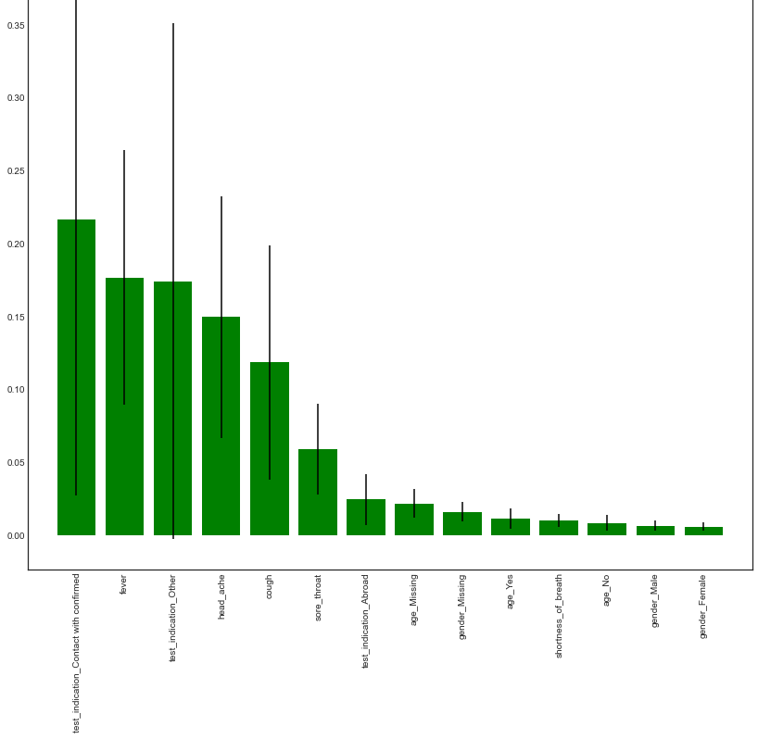
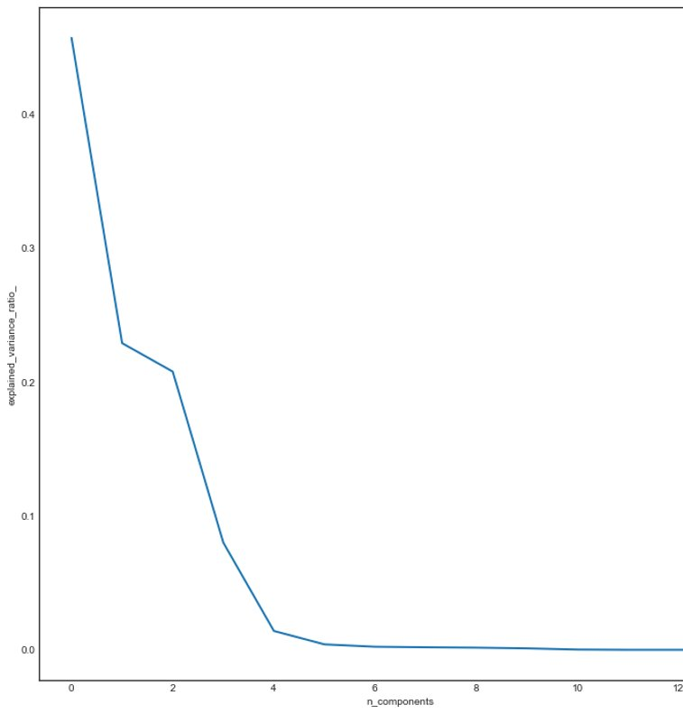
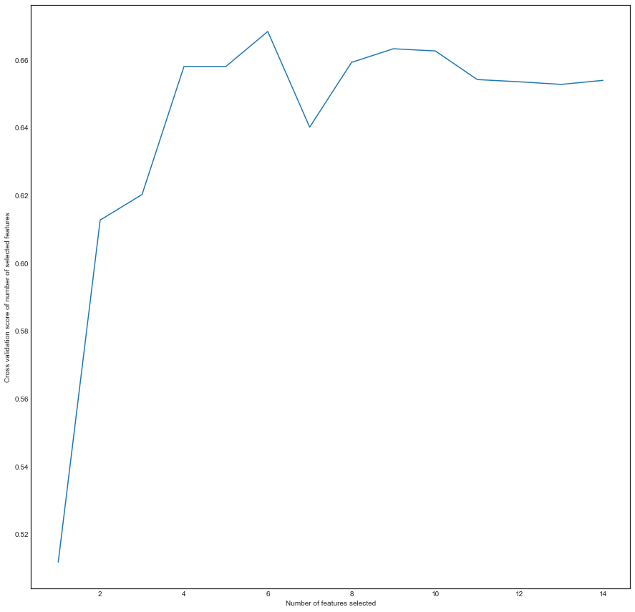
How many features should be selected --feature importance, PCA, REFCV

Slide 23
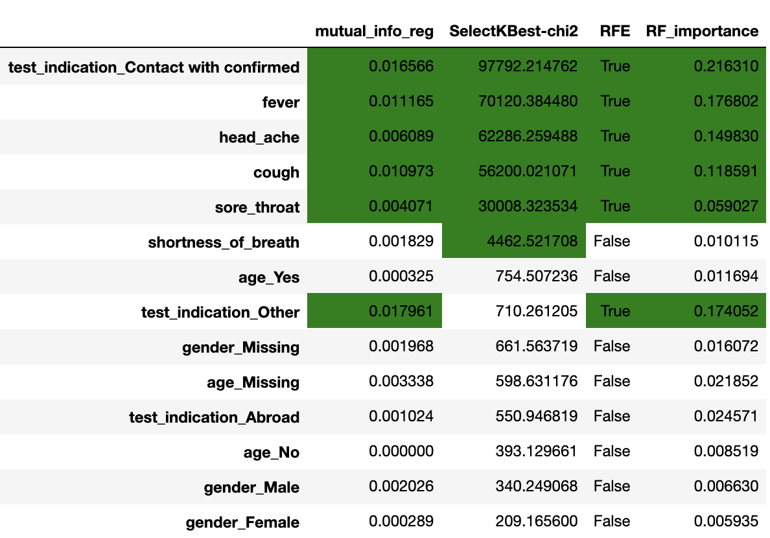
Which features should be selected

Slide 24
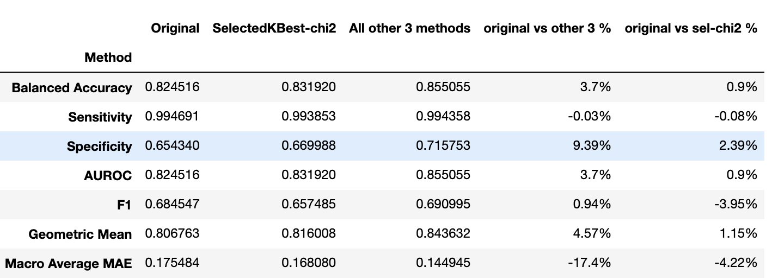
Finalizing the 6th feature

Slide 25
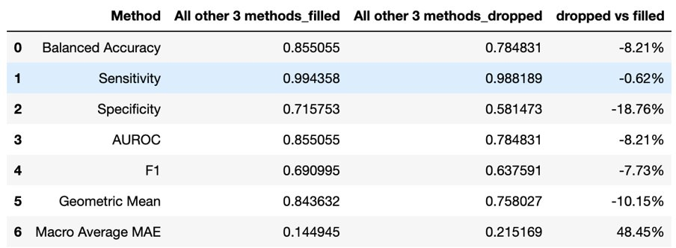
Filled vs dropped

Slide 26

Sampling & Modeling with imbalanced data

Slide 27
Sampling with imbalanced data
OverSample (Random over sample) Randomly duplicate the samples which are under-represented
SMOTE (Synthetic Minority Oversampling Technique) Generate new samples by interpolation
UnderSample (Random under sample) Randomly downsize the samples which are over-represented

Slide 28
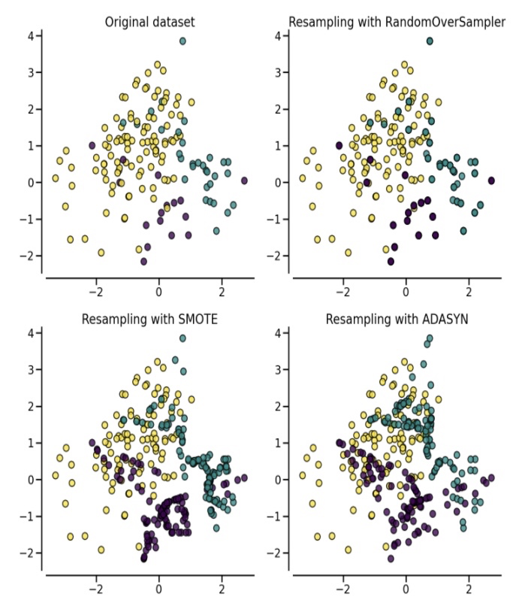
Sampling with imbalanced data
Random Sampler simply duplicates or deletes samples while the SMOTE Sampler generates new samples by creating similar samples next to original samples.

Slide 29
Modeling
Perceptron
Decision Tree
Gaussian Naïve Bayes
Random Forest
GradientBoostingForest
XGBoost
Nerual Network
Dummy Classifier
Most Frequent Classifier

Slide 30

Modeling
For implementing each Sampling method, repeating following steps:
Using Stratified K-Fold splitting (k = 10) method to split train-test samples
For training data, using different sampling method (over sample, SMOTE, under sample) to resample the training data and keep test data intact.
Run model to fit and predict for each model and record the metrics (for training data and test data)
Calculate the average metrics for 10 folds.

Slide 31
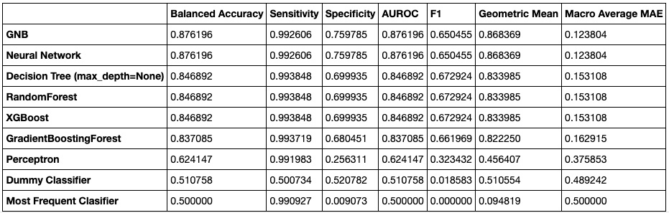
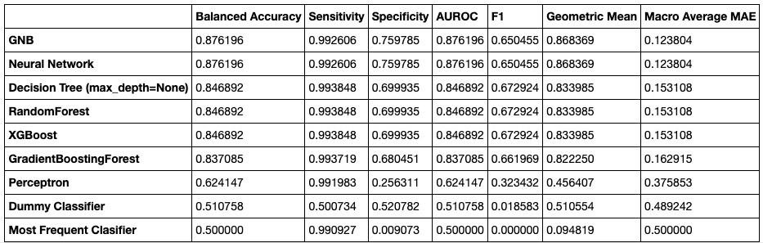
Performance (original sample)
Test dataset
Train dataset

Slide 32
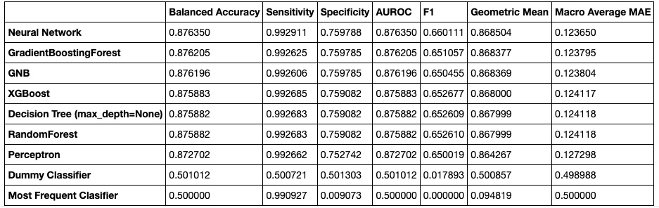
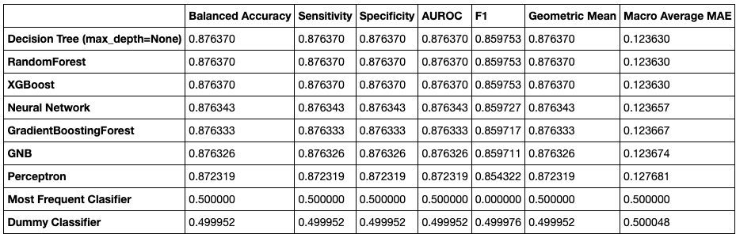
Performance (random over-sample)
Test dataset
Train dataset

Slide 33
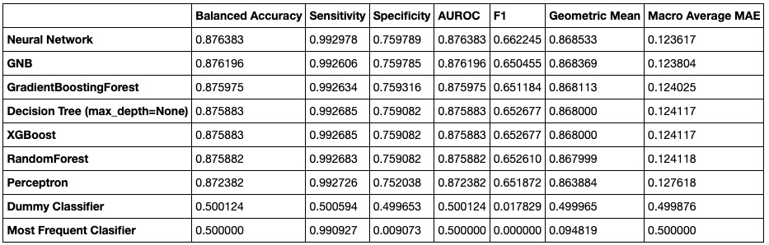
Performance (SMOTE)
Test dataset
Train dataset

Slide 34
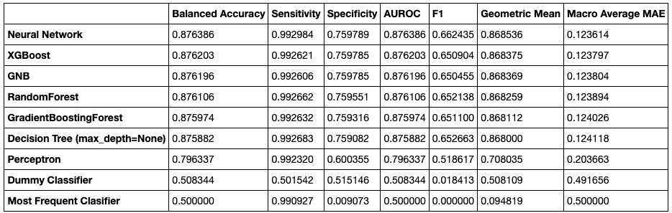
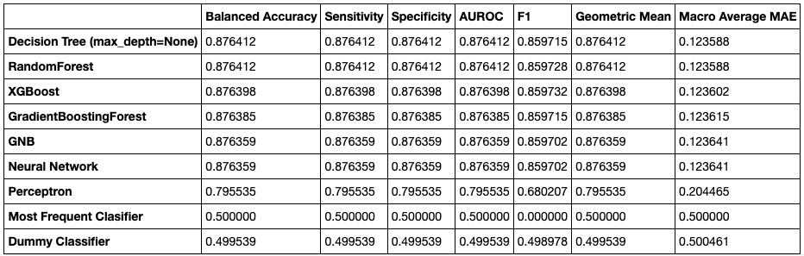
Performance (random under-sample)
Test dataset
Train dataset

Slide 35
Conclusion
Sampling method | Best Model | Performance (AUROC %)
Original Sampling | Neural Network, GNB | 87.62
Oversampling | Neural Network | 87.64
Oversampling with SMOTE | Neural Network | 87.64
UnderSampling | Neural Network | 87.64
The best performance we can get is from Neural Network.
Possible reasons for the current performances
hidden pattern in the data changes over time (virus mutation)
superficial and binary features can't guarantee a reliable prediction

Slide 36

Stay healthy and thank you!

Slide 37
Reference
https://github.com/guojunseven/Data-Mining-Project/blob/master/COVID19%20Diagnosis%20Prediction.ipynb
https://www.kaggle.com/kanncaa1/feature-selection-and-data-visualization
https://www.kaggle.com/prashant111/comprehensive-guide-on-feature-selection
https://imbalanced-learn.org/stable/references/metrics.html#module-imblearn.metrics
https://en.wikipedia.org/wiki/Template:COVID-19_pandemic_data
https://www.nytimes.com/interactive/2021/us/covid-cases.html
https://ourworldindata.org/coronavirus-data
https://github.com/CSSEGISandData/COVID-19
https://www.cdc.gov/coronavirus/2019-ncov/variants/delta-variant.html
https://imbalanced-learn.org/stable/over_sampling.html#naive-random-over-sampling

